Slide 1
Promotion and development of the Baltic Sea Cycle Route (Eurovelo10) in Denmark, Germany, Lithuania, Poland and Sweden

Slide 2
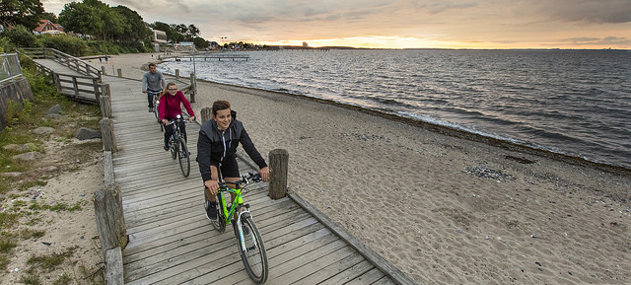
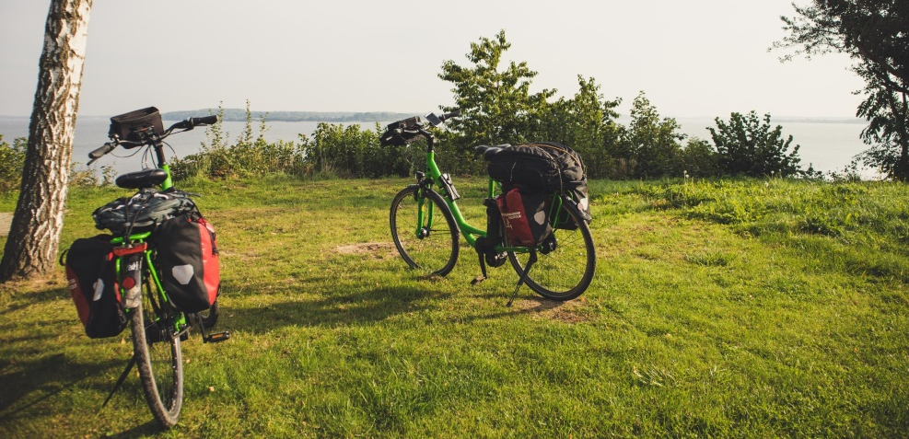
Project Partners:
Pomorskie Tourist Board – Lead Partner
Mecklenburg-Vorpommern Tourism Board
Pomorskie Voivodeship
Zachodniopomorskie Voivodeship
Danish Cycling Tourism
Centre for Regional and Tourism Research
European Cyclists' Federation

Slide 3
Associated Partners
The Regional Council in Kalmar County
Associacion „Klaipeda Region”
Ustka Community
Trzebiatow Commune
Ministry of Sport and Tourism
of the Republic of Poland

Slide 4
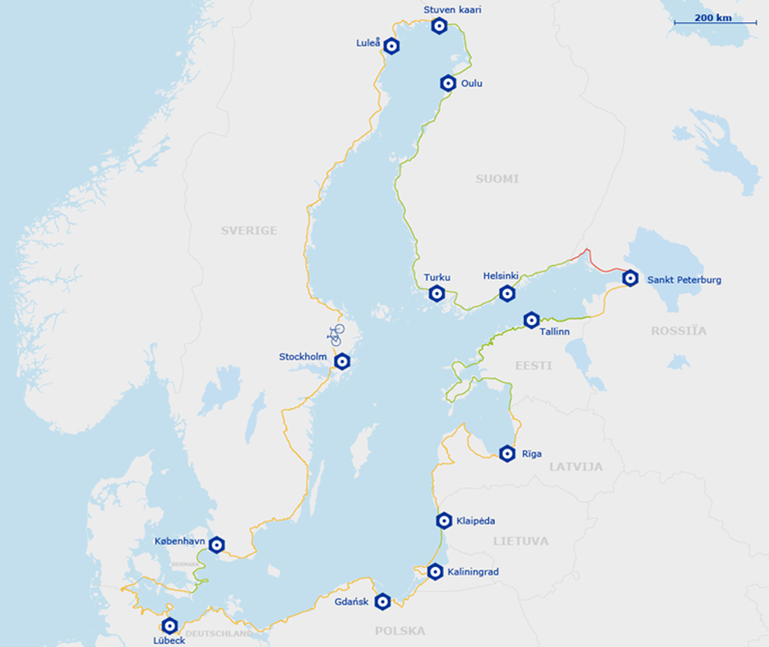
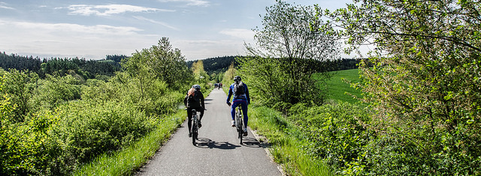
The main goals:
- exchanging knowledge about creating infrastructure, managing, commercializing and promoting the route
- cross border cooperation on creating and promoting cycle tourism products
- coordinating promotional activities
- surveying the intensity of cycle tourism and the preferences of route users
- elaborating a long term strategy for the development, marketing and promotion of cycle routes

Slide 5
Activities in the project:
- survey and analysis
- data base preparation
- preparing the strategy of development and promotion

Slide 6
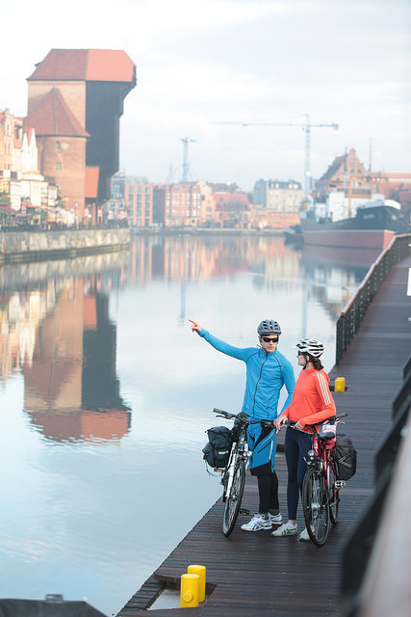
Activities in the project:
training for tourist information employees
- cooperation with tour operators
- promoting packages
- pilot investments

Slide 7
Lukasz Magrian
Project Manager
l.magrian@prot.gda.pl
+48 500 378 582
Photos courtesy of: Mecklenburg-Vorpommern Tourism Board, Danish Cycling Tourism, www.EuroVelo.com.

