Slide 1
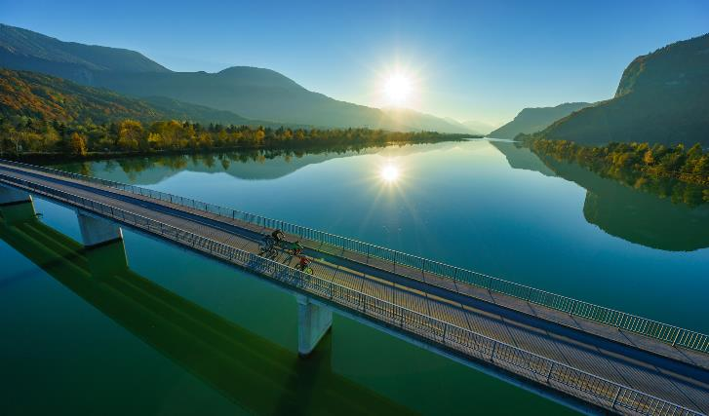

DRAURADWEG
The 5-Star Cycling Path on the southern side of the Alps
ITB 2018

Slide 2

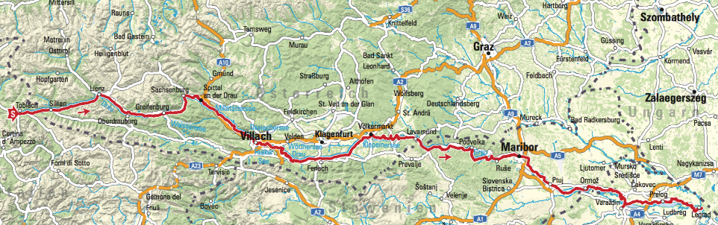
ITA
15k
AUT - Osttirol
50k
AUT – Kärnten
230k
SLO
150k
CRO
70km

Slide 3
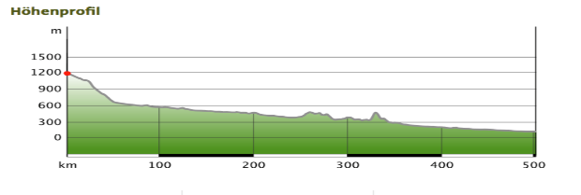
Facts
from Toblach (ITA) to Legrad (CRO), ca. 515 km, 1500 m↑, 2800m↓
continuously signposted (as R1 in Tirol and Carinthia)
mostly alongside the riverbank of river Drava
mostly perfect developed(asphalt or macadam)
ideal for trekkingbikes / E-Bikes
perfect for casual cyclists and families
many POI`s & lakes close to the cycling path

Slide 4
Drauradweg – historical development
during the `80 build in the course hydroelectric power stations development (ÖDK)
today`s cycling path was originally built as access and exit to construction area
first section: Spittal – Völkermarkt (1990 marked as R1)
Interreg project 2005 – 2008: bigger investment in infrastucture like path, resting places etc.

Slide 5
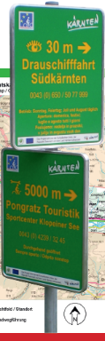
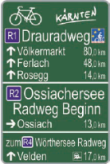
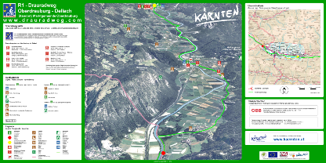
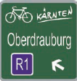
Der Drauradweg – signposting
permantently marked in both directions (Carinthia, Tirol)
big panorama signposts all 20 km
Drauradwegwirte and POI`s are marked too

Slide 6
Drauradweg –
Status Quo
Drauradweg-Wirte (accomodations, gastronomy, POI`s)
maintenance: region and provincial government
ADFC: 5-star quality cyling path (classification system)
app. 180.000 cyclists p.a. at the DRW counted in 2017
peak value July 2017: 3.800 cyclists a day(Villach, Friedensbrücke)
30 % locals, 60 % stage cyclists , 10 % day tripper

Slide 7
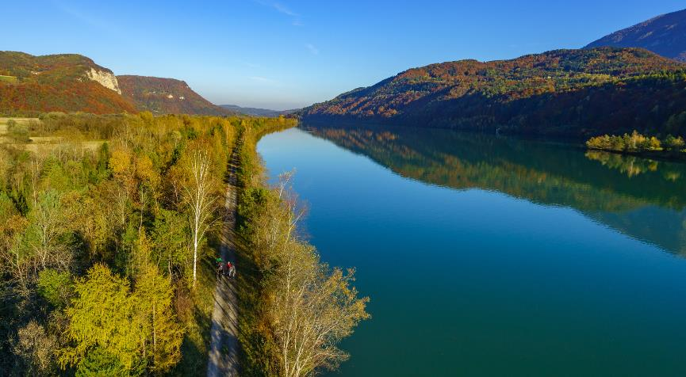
Development of quality

Slide 8
ADFC_classification 2012

Slide 9
result 2015- progress report

Slide 10
classification tool

Slide 11
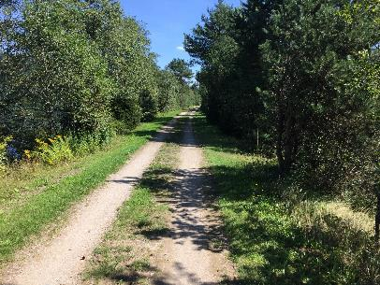
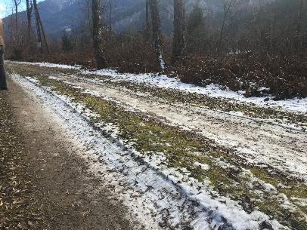
situation before restoration-
crooked lanes

Slide 12
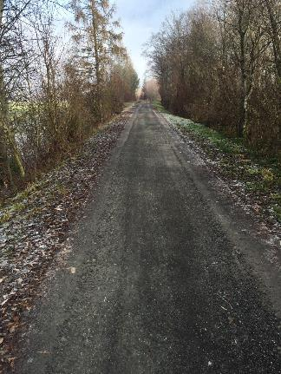
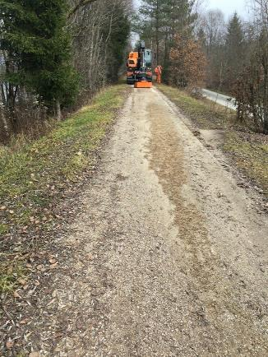
situation after restoration

Slide 13
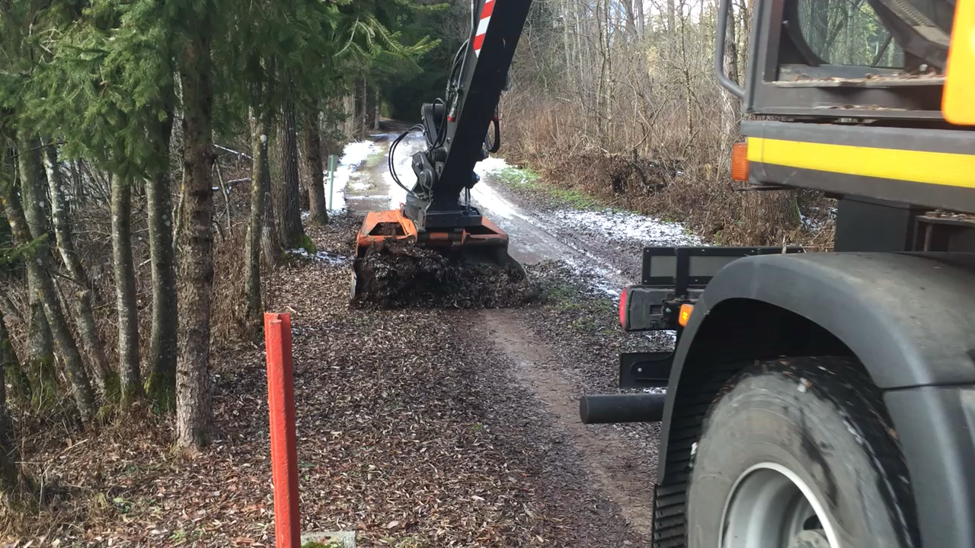
implementation

Slide 14
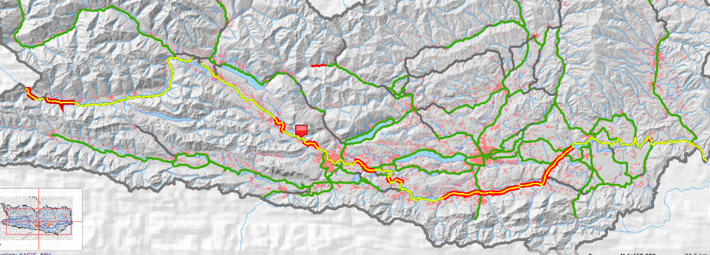
reconstructed sections in Carinthia

Slide 15
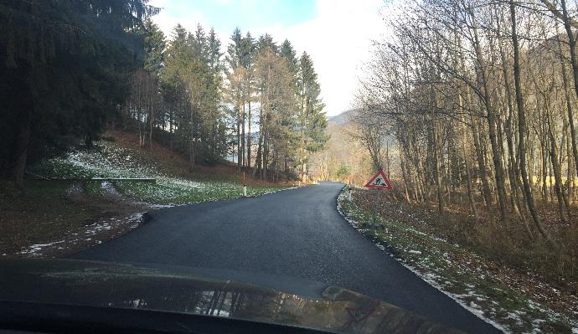
new road sections

Slide 16
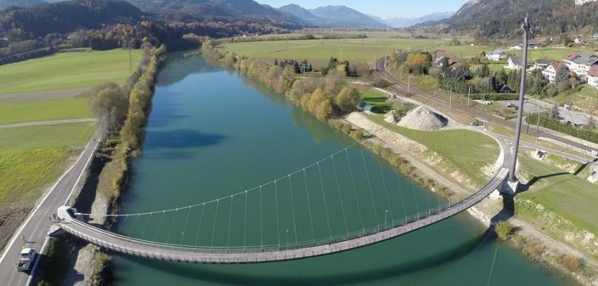
new bridge made for cyclists
Weißenstein/Puch

Slide 17
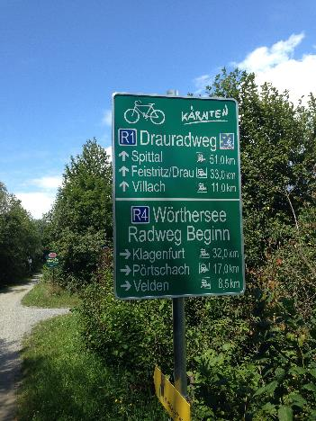
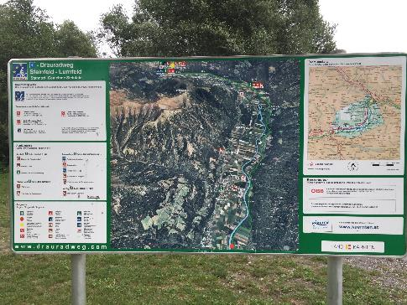
new signposting

Slide 18
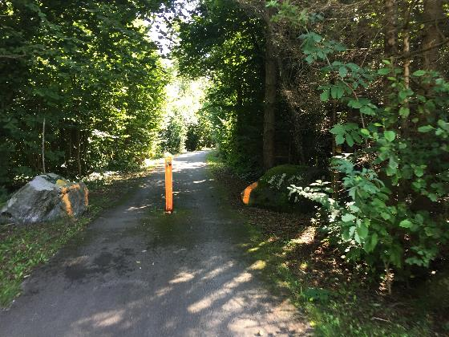
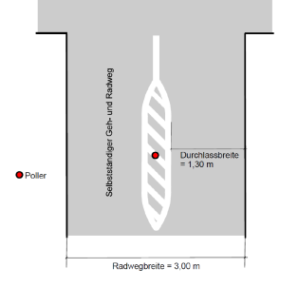
removal of dangerous spots-
(blocking devices etc)

Slide 19
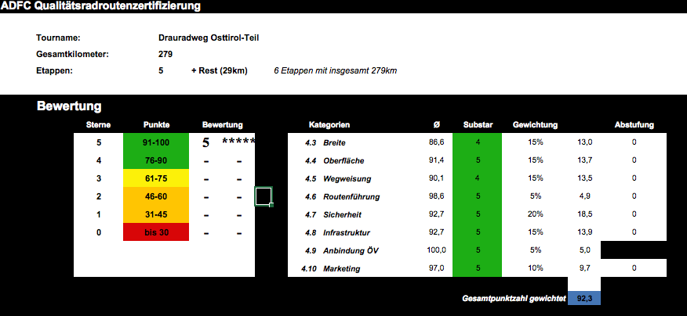
result 2016

Slide 20


Slide 21

Drauradweg_storytelling

Slide 22

initial position
Drauradweg is our key product in terms of leasure cycling
since 2016 on of only 4 5 star cycling pathes in Europe after ADFC regulations
one of the most popular cycling routes (German market)

Slide 23
terms of reference
developement due to segmentation compared to other cycling routes in Europe
new staging of cycling route with developement of storytelling as a manual for further marketing activities
increase of benefit for guest/cyclist and tourism in Carinthia
activation of a new class of guests

Slide 24
steps
intensive cooperation with partners in South Tirol, East Tirol, Slovenia and Croatia
common marketing strategy of those 5 partners in future
expansion of cycling route in Slovenia and Croatia `till 2020
extention of route from actual 320km to more than 530km in future
much better integration of different POI`s alongside the river Drava
intensive connection between Drava cycling route and well known Carinthian lakes
common corporate design of resting areas and information points in Italy, Austria, Slovenia and Croatia
minimum 4 new resting areas in Carinthia during next 3 years

Slide 25
Thanks a lot for your attention

