Slide 1
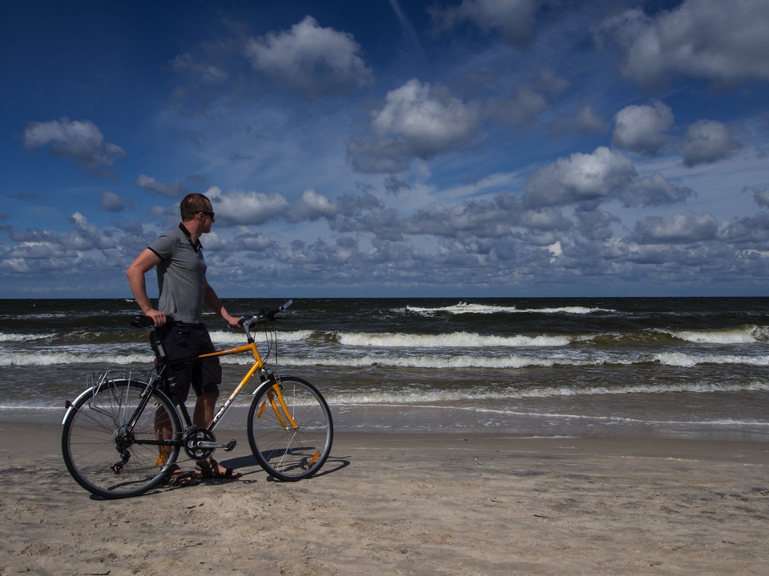
Marco Ciarrocchi
European Cyclists’ Federation
7 March 2018
ITB – Berlin, Germany

Slide 2
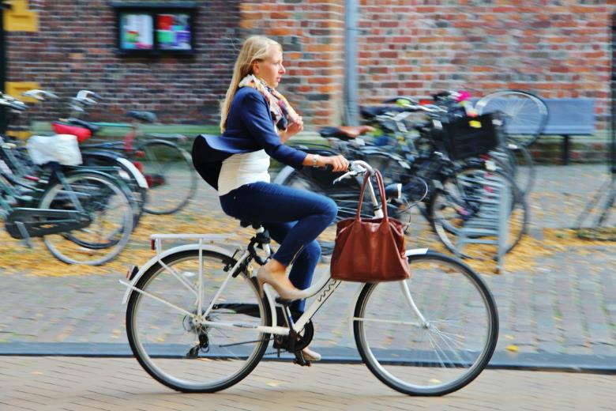
INTRODUCING ECF
Notes:
World’s largest cyclists’ advocacy organisation
One goal → To promote cycling as a sustainable and healthy means of transportation and recreation

Slide 3
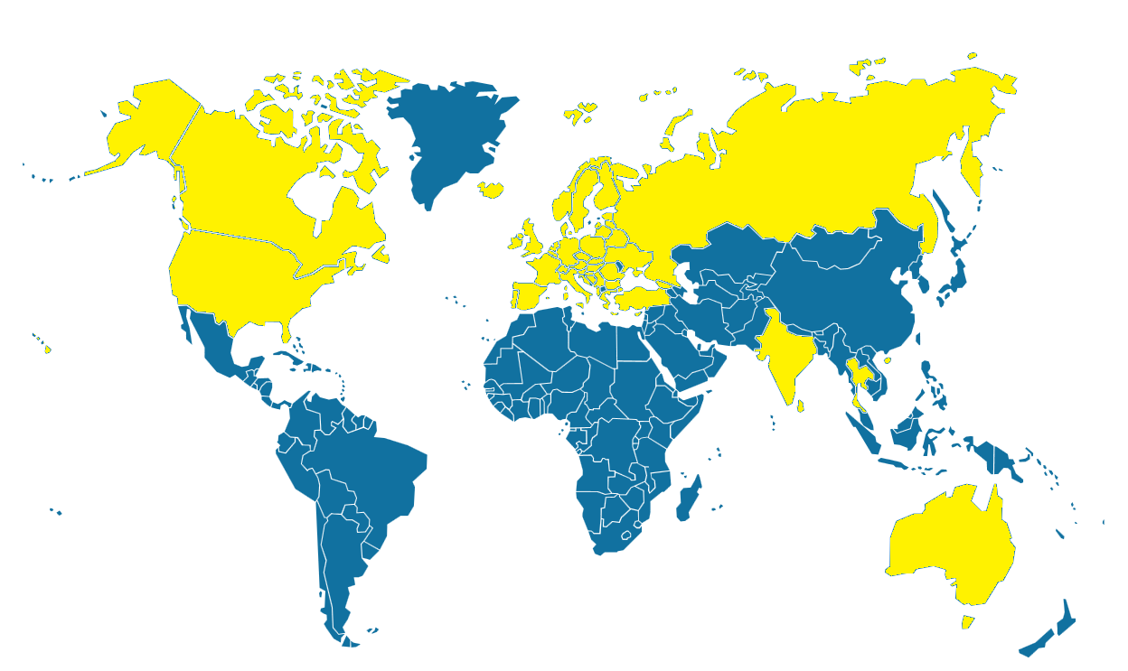
Notes:
ECF was founded in 1983 by 12 bicycle user associations. It has now more than 80 member organizations representing individual citizens from 45 countries worldwide.
ECF actively promotes and encourages cycling worldwide while trying to enforce cycling policy at European level.

Slide 4
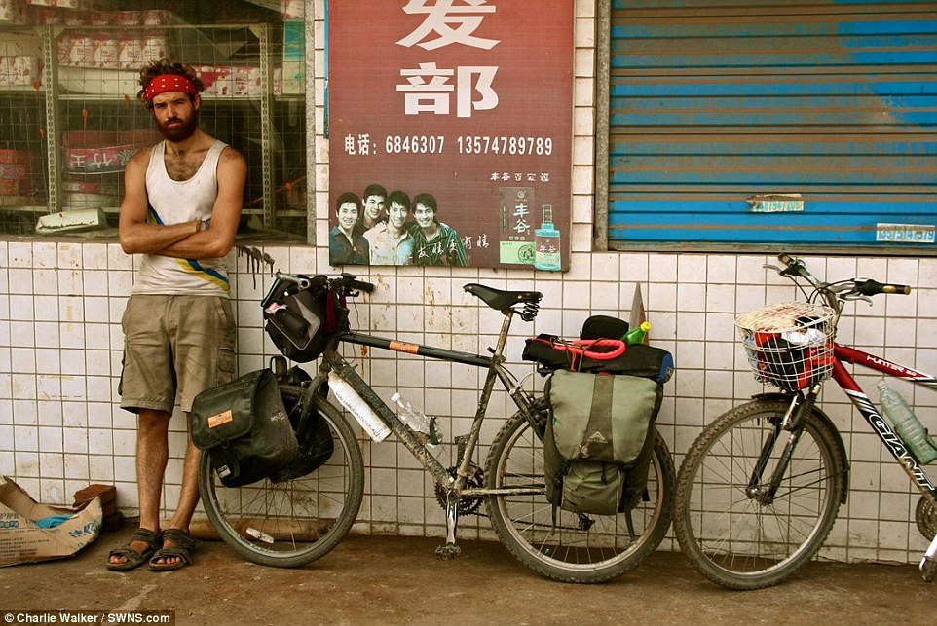
Cycle tourism has changed…
Notes:
ECF promotes cycle tourism as a sustainable economic factor and environment-friendly mobility.

Slide 5
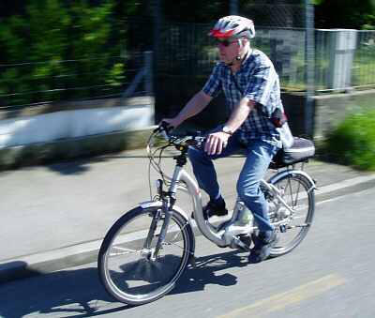
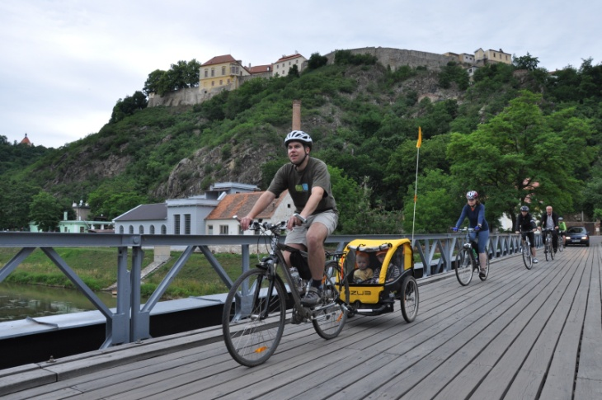
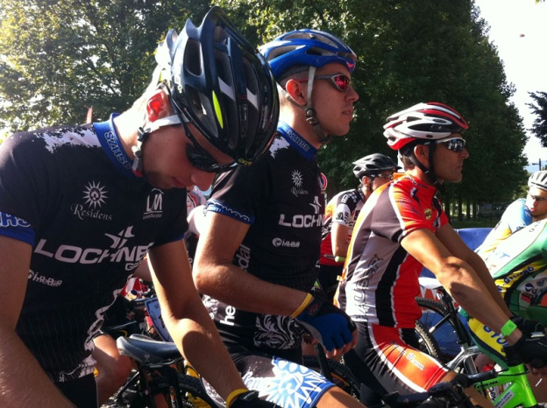
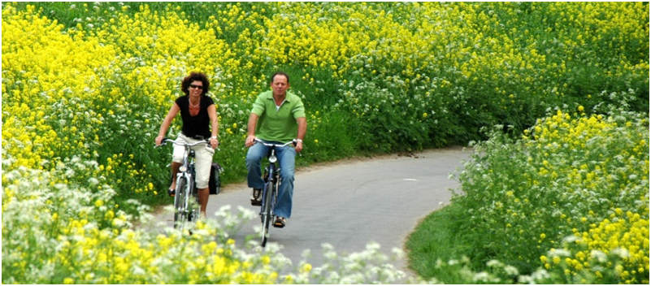
…and moved into the mainstream.
Notes:
cyclists on cycling holidays;
holiday cyclists (cycling during a generally “non-cycling” holiday);
cyclists on day trips for leisure; and
sporting and fitness cyclists.

Slide 6
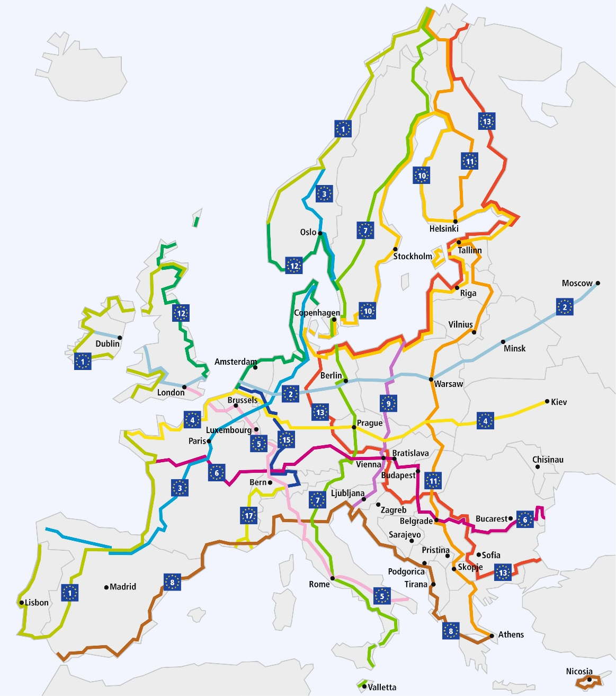
15 long distance cycle routes:
9 North – South Routes;
4 West – East Routes;
2 circuits.
Network: over 70,000 km
Notes:
EuroVelo is the European cycle route network – a network of 15 long distance cycle routes that connect the whole continent.
Founded in 1995, the routes can be used by long-distance cycle tourists, as well as by local people making daily journeys.
The network is developed and coordinated by the European Cyclists’ Federation (ECF) on the European level with a network of National EuroVelo Coordination Centres working to realise the routes on the ground.

Slide 7
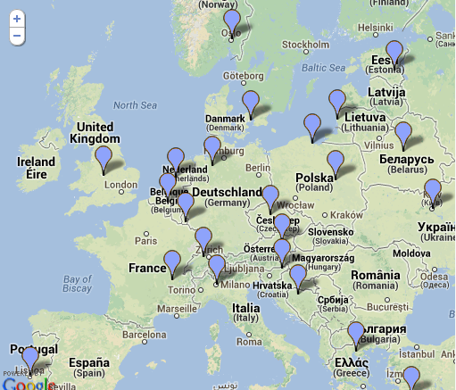
1 ECF – EuroVelo management team and EuroVelo council
21 National EuroVelo Coordination Centres and Coordinators
7 National EuroVelo Contact Points
Notes:
Eurovelo governance:

Slide 8
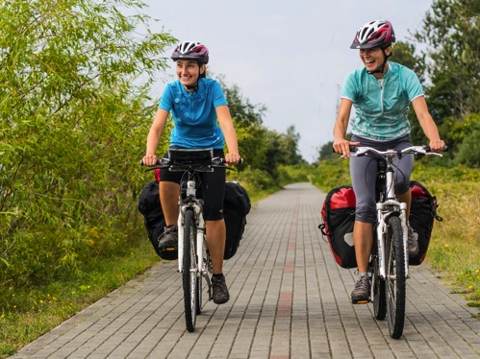
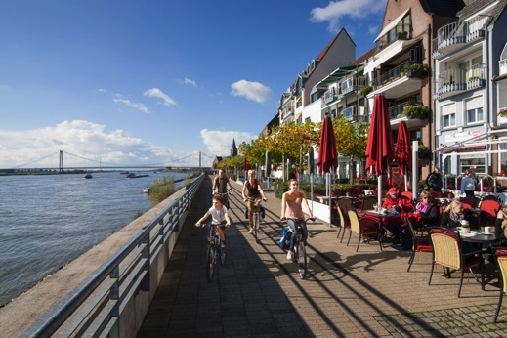
Cycle tourism is booming • 2.3 billion cycle tourism trips in Europe every year; • of which 20.4 million include at least one overnight stay; • when complete, the EuroVelo network will generate 60 million trips creating a total of €7 billion of direct revenue.
Why EuroVelo
• EuroVelo incorporates some of the most attractive and popular cycle routes (Rhine Route, Loire à vélo, the Danube Cycle Path, etc.).
• EuroVelo provides a gateway for anyone wanting to cycle in Europe.
• Communication and promotional tools.

Slide 9
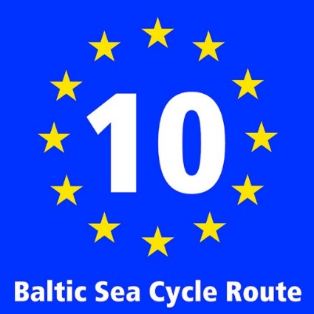
9 Countries
Poland – Germany – Denmark – Sweden – Finland - Russia – Estonia- Latvia -Lithuania
7,980 km
6 Capitals
Copenhagen, Stockholm, Helsinki, Saint Petersburg, Tallinn, Riga.
Notes:
The Baltic Sea coast with its white sands, quaint towns and ice-blue water is an attractive destination and EuroVelo 10 will give you the perfect opportunity to get better acquainted with this corner of Europe. Exploring the beguiling capitals Tallinn and Riga, the glamorous city of Saint Petersburg or the Hanseatic towns provide lots of culture while in between, the shorelines and the woodlands that border them along the proximate 8,000 km provide lots of opportunities to experience unspoilt nature.

Slide 10
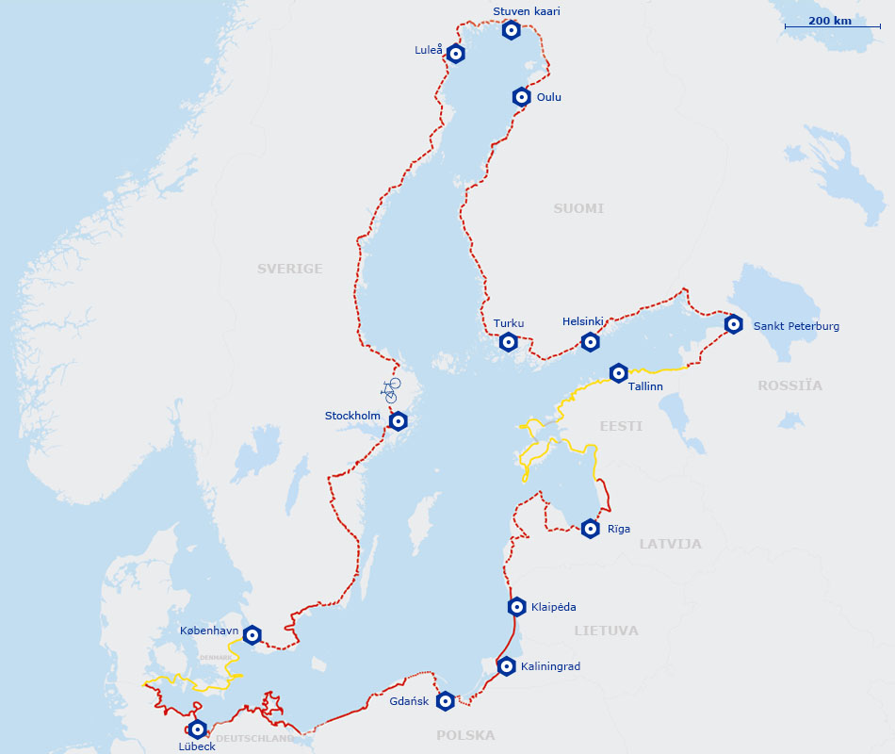

Slide 11
Baltic Sea Cycle Route Copenhagen-Gdańsk
Improvement, promotion, connection and coordination of the natural and cultural tourist resources of South Baltic areas' coastal regions as a cross-border, sustainable, well-recognized cycle tourism product.
Building cross-border cooperation in the field of cycling tourism between South Baltic countries to increase the sustainability of tourism in the whole region.
Notes:
The overall idea of the project is the improvement, promotion, connection and coordination of the natural and cultural tourist resources of South Baltic areas' coastal regions as a cross-border, sustainable, well-recognized cycle tourism product: Baltic Sea Cycle Route Copenhagen-Gdańsk. Building cross-border cooperation in the field of cycling tourism between South Baltic countries will increase the sustainability of tourism in the whole region.

Slide 12
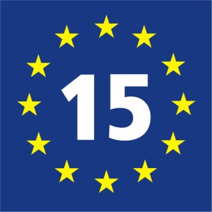
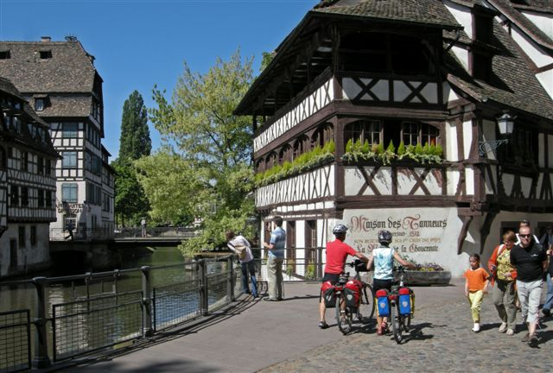
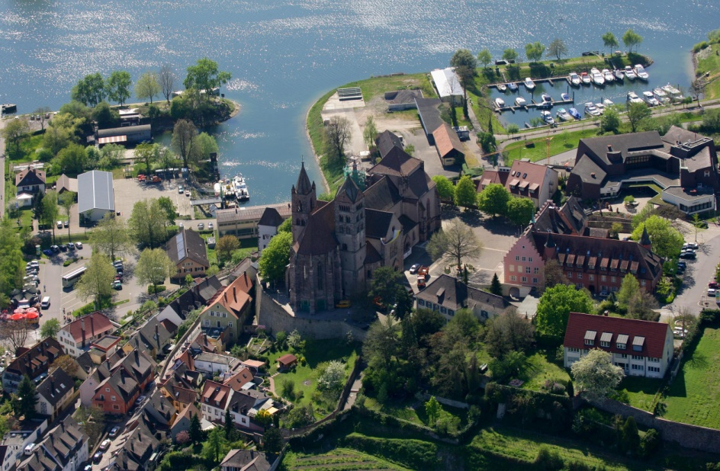
Best practices: EuroVelo 15 – Rhine Cycle Route

Slide 13
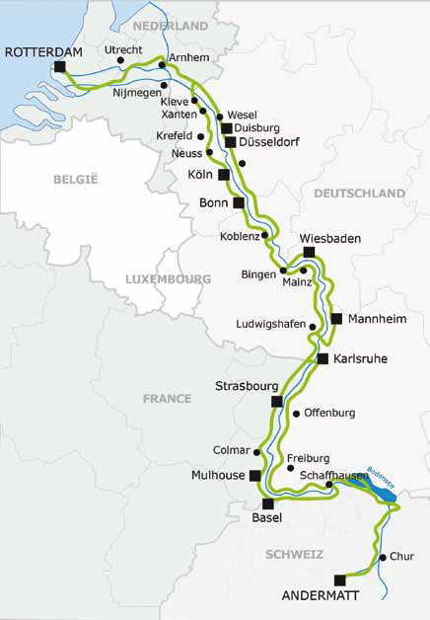
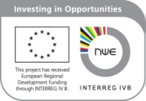
Best practices: EuroVelo 15 – Rhine Cycle Route
INVESTMENT
2,3 Million Euro investment on the trans-national level – DEMARRAGE project (2011 – 2014).

Slide 14
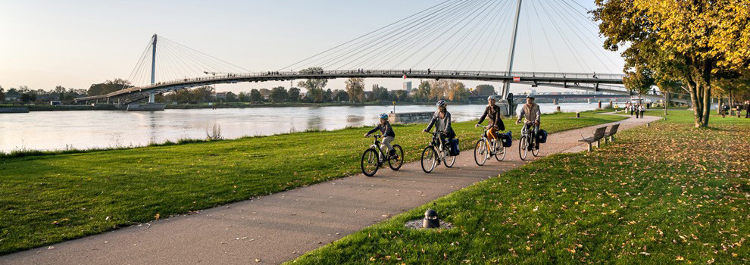
Best practices: EuroVelo 15 – Rhine Cycle Route
SUSTAINABILITY
A sustainable trans-national cooperation: Switzerland, France, Germany, Netherlands.
Long-term management signed for three (2015 – 2017) + three more years (2018 – 2020)

Slide 15
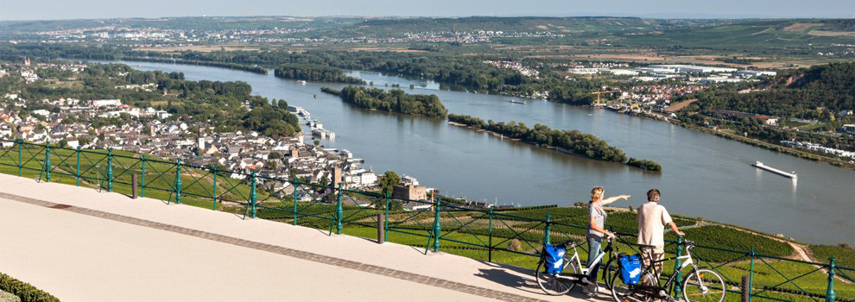
Best practices: EuroVelo 15 – Rhine Cycle Route
ACTIVITIES
Route infrastructure: coordination of itinerary and signing systems on trans-national level;
Services: transnational network of businesses and entrepreneurs.
Marketing, promotion, communication: touristic information on transnational level.
Monitoring & evaluation: usage, monitoring and economic impact.

Slide 16
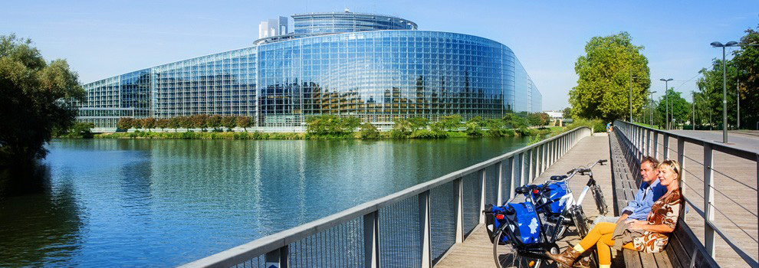
Best practices: EuroVelo 15 – Rhine Cycle Route
RESULTS
3rd most popular long-distance cycling route in Germany.
In the top ten of the most popular long-distance cycle routes outside of Germany.
Over 700,000 page views in 2016 (almost 20% of the visits to www.EuroVelo.com).

Slide 17
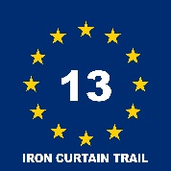
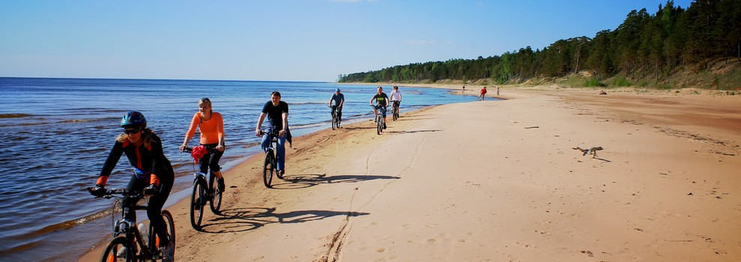
MANY PROJECTS, ONE METHODOLOGY
EuroVelo 5 – Via Romea Francigena
EuroVelo 13 - Iron Curtain Trail
Silver Cyclists

Slide 18
EV 10 – Baltic Sea Cycle Route, an opportunity for tour operators!
Over 4.2 million page views on EuroVelo.com over the past year.
Main overview website providing information to explore Europe by bike.
Top 5 countries of origin: France, UK, Germany, Spain and the US.

Slide 19
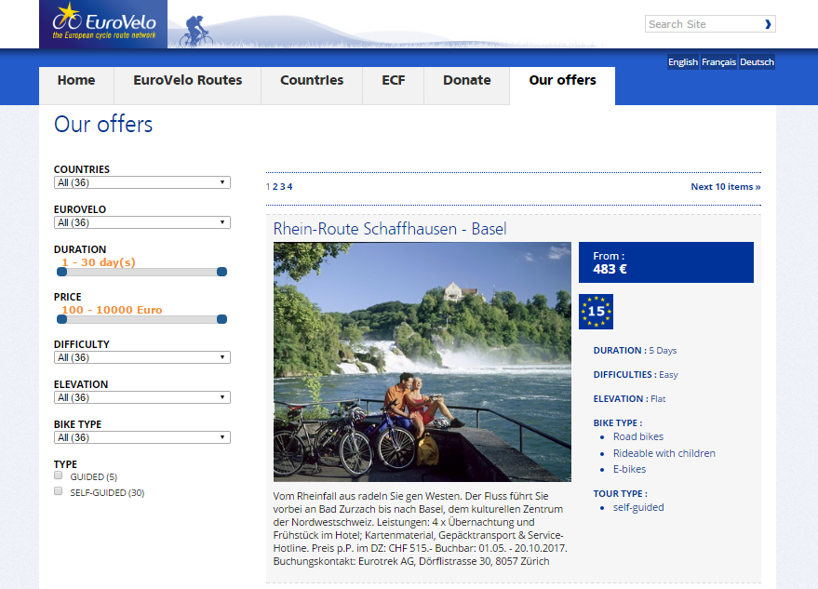
Bookable offers

Slide 20
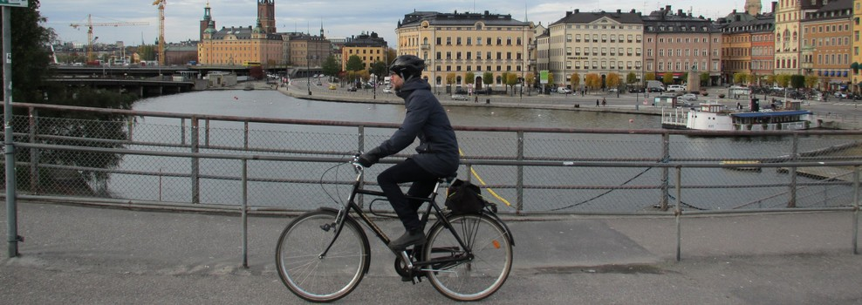
Specific information
Natural, cultural and UNESCO sites along the routes.
Detailed information about Stages.
Services, special offers and contact details.

Slide 21
User-friendly official apps
Route overview;
links to where you can find detailed information in each country or region;
reward system that allows to ‘check in’ to the points of interest;
share with your friends and family how much of the route you have completed.

Slide 22
Marco Ciarrocchi
m.ciarrocchi@ecf.com
www.ecf.com www.eurovelo.com

