Slide 1


Biking South Baltic with
„Die Mecklenburger Radtour“
ITB Workshop 2018
Best practice example:
baltic sea cycle route and cross-border tours
By Jaana Trebesius, Marketing & Sales – Die Mecklenburger Radtour GmbH

Slide 2
Structure
ITB Workshop 2018
About us
Relevant products:
  German Baltic Sea Cycle Route
  Cross-border Germany-Poland
  Cross-border Germany-Denmark
  Partner tours
Cross-border cooperation: difficulties
Prospects: basic requirements for creating new products on Baltic Sea Cycle Route
Conclusion

Slide 3
About us: Who we are
ITB Workshop 2018
number 1 company for cycling holidays in Mecklenburg-Western Pomerania and the other former GDR states with 25 years of experience
over 150 original cycle tours planned and organized by us
ca. 200 tours provided through partnerships with reliable travel companies in Germany and other European countries
family business: small team of tourism professionals, mechanics and guest relation managers at the main office in Stralsund/Baltic Coast as well as in our holiday regions

Slide 4
About us: What we do
ITB Workshop 2018
Reservation of hotel accommodation incl. breakfast
Luggage transport from hotel to hotel
Service hotline
Rental bike service with solid brand bikes
Substantial travel information package with route description and maps
Ferry rides, train rides and entry fees on selected tours

Slide 5
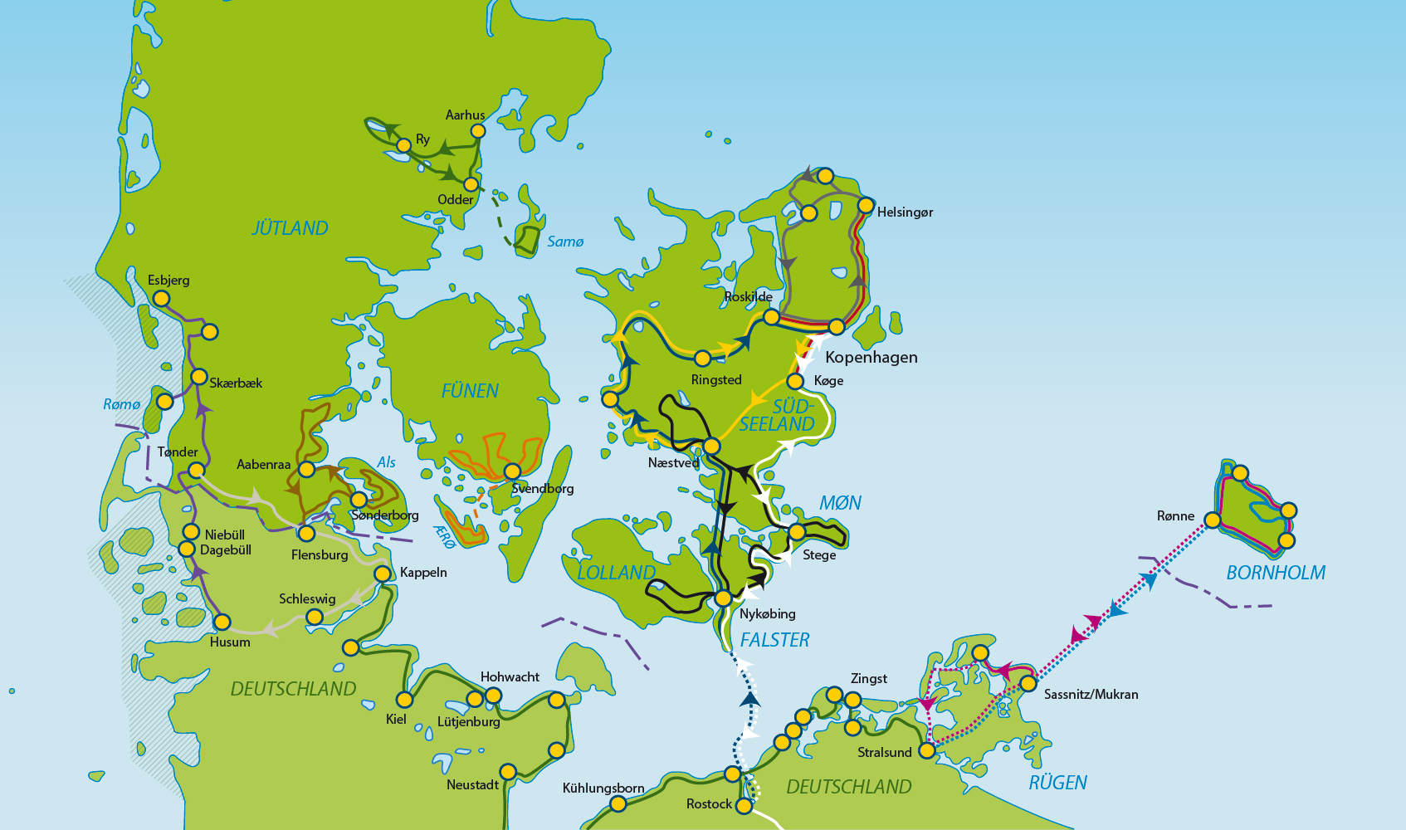
Tours in the baltic region
ITB Workshop 2018
Notes:
As you can see, mostly in Germany and Denmark
Also one tour from Stralsund to Stettin, did not fit on this map aymore, but we will see it on the next

Slide 6
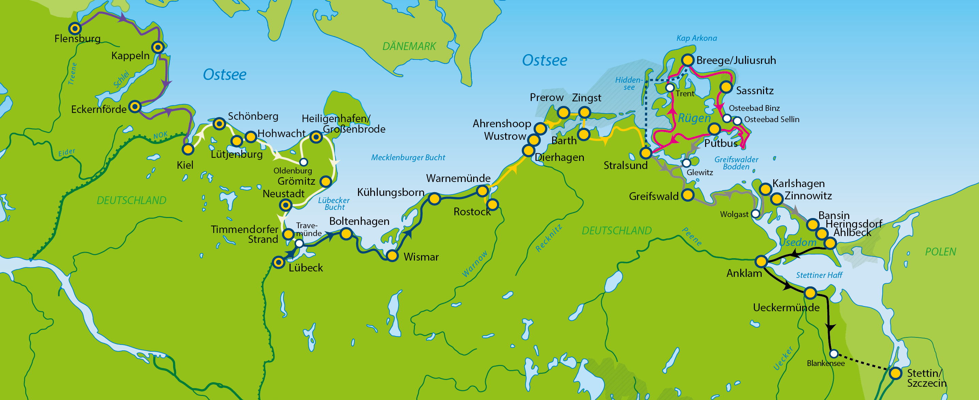
German Baltic Sea Cycle Route
ITB Workshop 2018
ca. 30 tours between Flensburg and Heringsdorf (Usedom/Uznam)
most popular: Lübeck – Stralsund, Rügen, Flensburg – Lübeck
Notes:
Here we can see the German Baltic Coast and as you can see we display the complete coast in our tours
Now let‘s have a look at our cross-border tour Stralsund-Szczecin

Slide 7
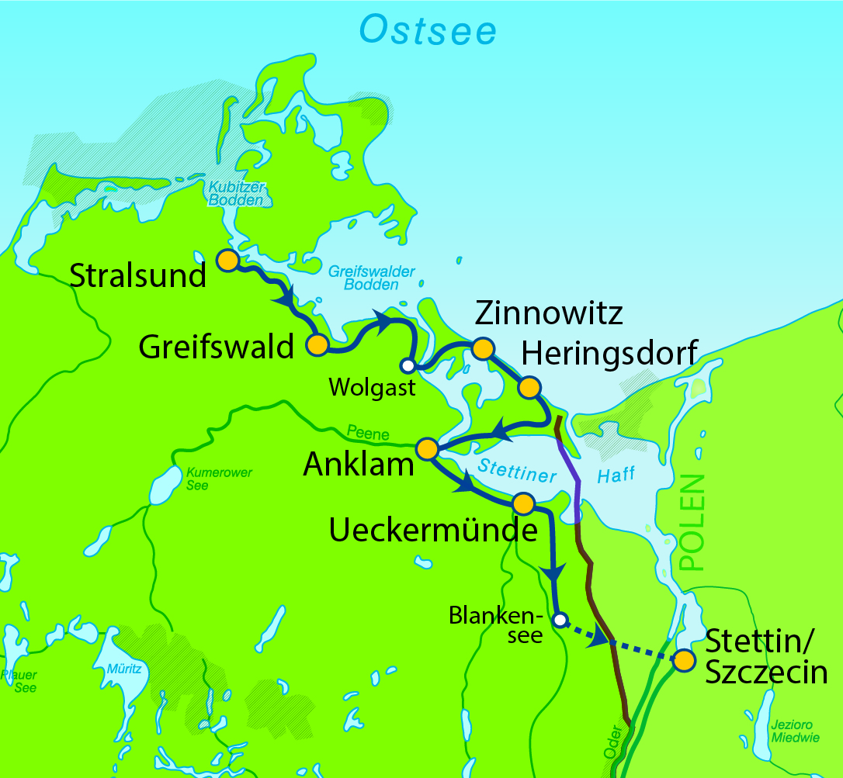
Cross-border Germany-Poland
ITB Workshop 2018
Stralsund to Stettin/Szczecin
8 Days / 7 Nights
Service
Accommodation for 7 nights
Breakfast included
Luggage transfer service to each hotel
7-Day-Service-Hotline
On-site tour presentation
1x tour information package per room
GPS-track on request
Transfer from Hintersee to Sczcecin
Entry to Pommersches Landesmuseum in Greifswald
Entry to Otto-Lilienthal-Museum in Anklam
Extras
Rental bicycle with cycling bag: € 80,–
Electric bicycle: € 190,–
Return Transfer Service to Luebeck (incl. bike) per person: € 60,–
Dates: 21.04. - 30.09.2018 Start: daily
Close out dates: 05.08.-08.08.
Notes:
Transfer by car from border region to Szczecin (German provider) → no good cycle path (?)
Polish hotel partners in Szczecin

Slide 8
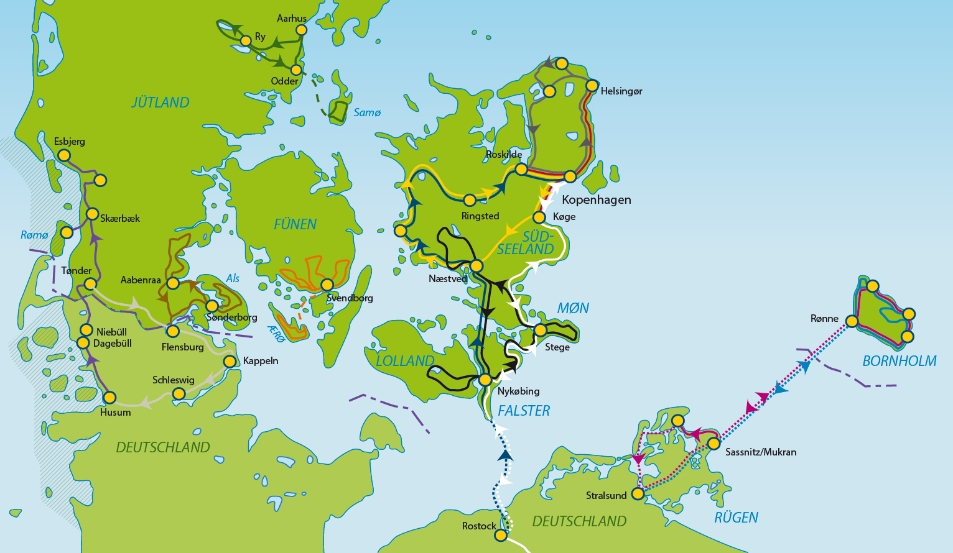
Cross-border Germany-Denmark
ITB Workshop 2018
ca. 15 tours in Denmark
9 of them cross-border:
  Berlin to Copenhagen and reverse as well as parts of it
  Danish Baltic Coast Explorer (Rostock-Copenhagen)
  Rügen and Bornholm
  New in 2018:
  North Sea Cycle Route Husum-Esbjerg,
  North- and Baltic Sea combining round trip &
  Southeast-Jutland from Flensburg
Notes:
- Own German guest representative sent to Zealand and Bornholm for the season (luggage and bike service, service hotline)

Slide 9
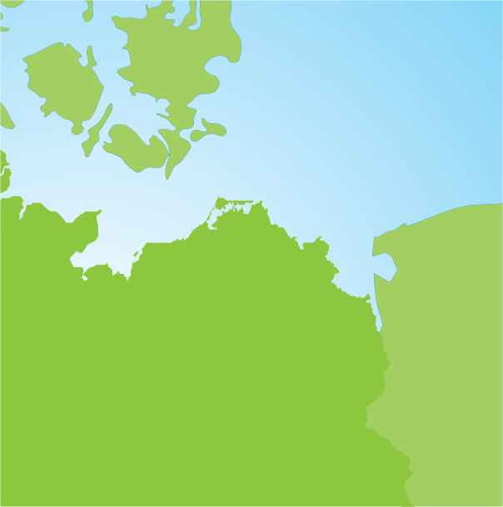
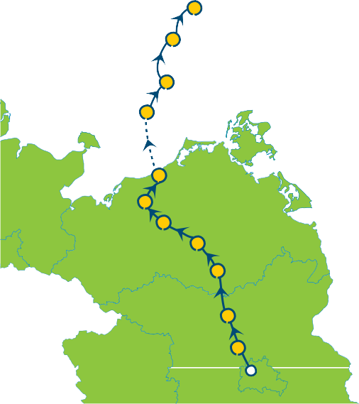
Cross-border Germany-Denmark
ITB Workshop 2018
Berlin to Copenhagen
11 Days / 10 Nights
Service
Accommodation for 10 nights (according to booking category)
Breakfast included
Ferry from Rostock to Gedser (Germany to Denmark)
Admission to the Müritzeum museum
Luggage transfer service to each hotel
On-site tour presentation
7-Day Service Hotline
1x Tour information package per booked room
GPS-Track on request
Extras
Rental bicycle with cycling bag: € 110,–
Electric bicycle: € 280,–
Dates: 04.06. - 27.08.2018 Start: every Monday
From 12.07. - 16.08.2018 Start: every Monday & Thursday
Close out date: 06.08.
Kopenhagen
Køge
DENMARK
Stege Baltic Sea
Nykøbing
Rostock Güstrow
Krakow
GERMANY
Waren
Neustrelitz
Fürstenberg Oranienburg
Berlin
from € 1.199,–
Notes:
- Most popular for international clients, especially overseas

Slide 10
Partner tours
ITB Workshop 2018
appx. 200 partner tours in Germany and Europe
baltic coast: Baltic States & Denmark
  Swinemünde/Świnoujście – Gdansk
  Vilnius – Riga – Tallinn
  Memel Territory and Curonian Spit
  Copenhagen-Helsingør-Hillerød-Roskilde-Copenhagen
  Small roundtrip Jutland from Aarhus
Cooperation – 2 partners in 1 tour: Bremen - Kiel
Notes:
Partner tours = we are reselling tours of local tour operators to our clients on a commission basis. Every partner sells the same tour for the same price for a fair partnership

Slide 11
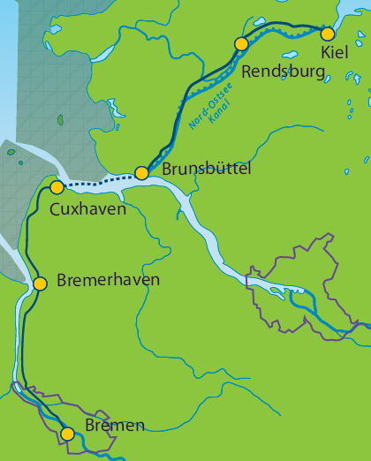
Cooperation: 2 in 1
ITB Workshop 2018
Bremen to Kiel
7 Days / 6 Nights
Service
Accommodation for 6 nights
Breakfast included
Ferry from Cuxhaven to Brunsbüttel
Luggage transfer service to each hotel
On-site tour presentation
7-Day Service Hotline
1x Tour information package per booked room
GPS-Track on request
Extras
Rental bicycle with cycling bag: € 70,–
Electric bicycle: € 170,–
Dates: 28.04. - 30.09.2018 Start: every Saturday & Sunday
from € 540,–
Notes:
- our partner oragnises the part from Bremen to Cuxhaven, we organise the part from Brunsbüttel to Kiel
- this could also work for cross-border products

Slide 12
Difficulties in cross-border products
ITB Workshop 2018
ACCOMMODATION / INFRASTRUCTURE
different structure of accommodation (less hotels, more holiday homes and small B&Bs)
Hotels: certification and standards (none or different)
→ problems in categorisation for customer
  intensify the international standardization and certification
COOPERATION
Hotels: lack of willingness to cooperate (no 1-nights stays, no special prices)
  help of destination management organisations needed
partly long distance between head office and travel region/partners
→ many differences/problems are easier solved in personal meetings

Slide 13
Difficulties in cross-border products
ITB Workshop 2018
COMMUNICATION
language → misunderstandings possible
  language tutoring
slower communication
  intercultural tutoring
STANDARDS
different currencies with non-EUR-countries Poland and Denmark
  banks offer money transfer in foreign currency to avoid contradictions due to currency fluctuations
different terms of payment/business (pre-payment, credit card, standards for invoices)
  confidence in business partners, assimilation of international/european standards by legislators

Slide 14
Creating new products on
Baltic Sea Cycle Route: basic requirements
ITB Workshop 2018
PUBLIC INFRASTRUCTURE
good quality of cycle paths (no cobblestone, no old flagstone paths,
avoiding sand/dirt road)
good quality and quantity of signs
good possibilities to take the bike with you in public transport
more E-Bike infrastructure such as recharging spots (public as well as at hotels)

Slide 15
Creating new products on
Baltic Sea Cycle Route: basic requirements
ITB Workshop 2018
SERVICE INFRASTRUCTURE
cyclist-friendly hotels, open minded to cooperate with cycle tour operators
resp. to accommodate guests for one night also in high season
supporting local food service enterprises in rural regions as stops for breaks
INTERNATIONAL MARKETING
our experience shows that many providers at the baltic coast are not yet attuned
to international guests (no credit card payment, no multilingual information etc.)
tourism regions need to perceive Baltic Sea Cycle Path as an international path
with international guests and to communicate this with their service providers
Notes:
Resp.= respectively (= bzw.)

Slide 16
Conclusion
ITB Workshop 2018
partners/service providers in all Baltic Sea countries must be sensitised and be open-minded for cross-border partnerships
tour operators should have the courage to create cross-border products and demand, but also find solutions by themselves to minimise the possible problems
public organisations and tourism board are needed for this process
We see the potential to promote Baltic Sea Cycle Path worldwide
Combining parts of the path with internationally known cities such as Copenhagen, Hamburg, Berlin and Gdansk makes it more interesting and perceptible for international partners and guests
That is how we are succeeding in promoting this region not only in Germany but also in other European countries and in Northern America

Slide 17
Conclusion
ITB Workshop 2018
If the public and private sector work together and provide the
conditions stated, there is a good chance to extend and improve
cross-border products on the Baltic Sea Cycle Path!

Slide 18
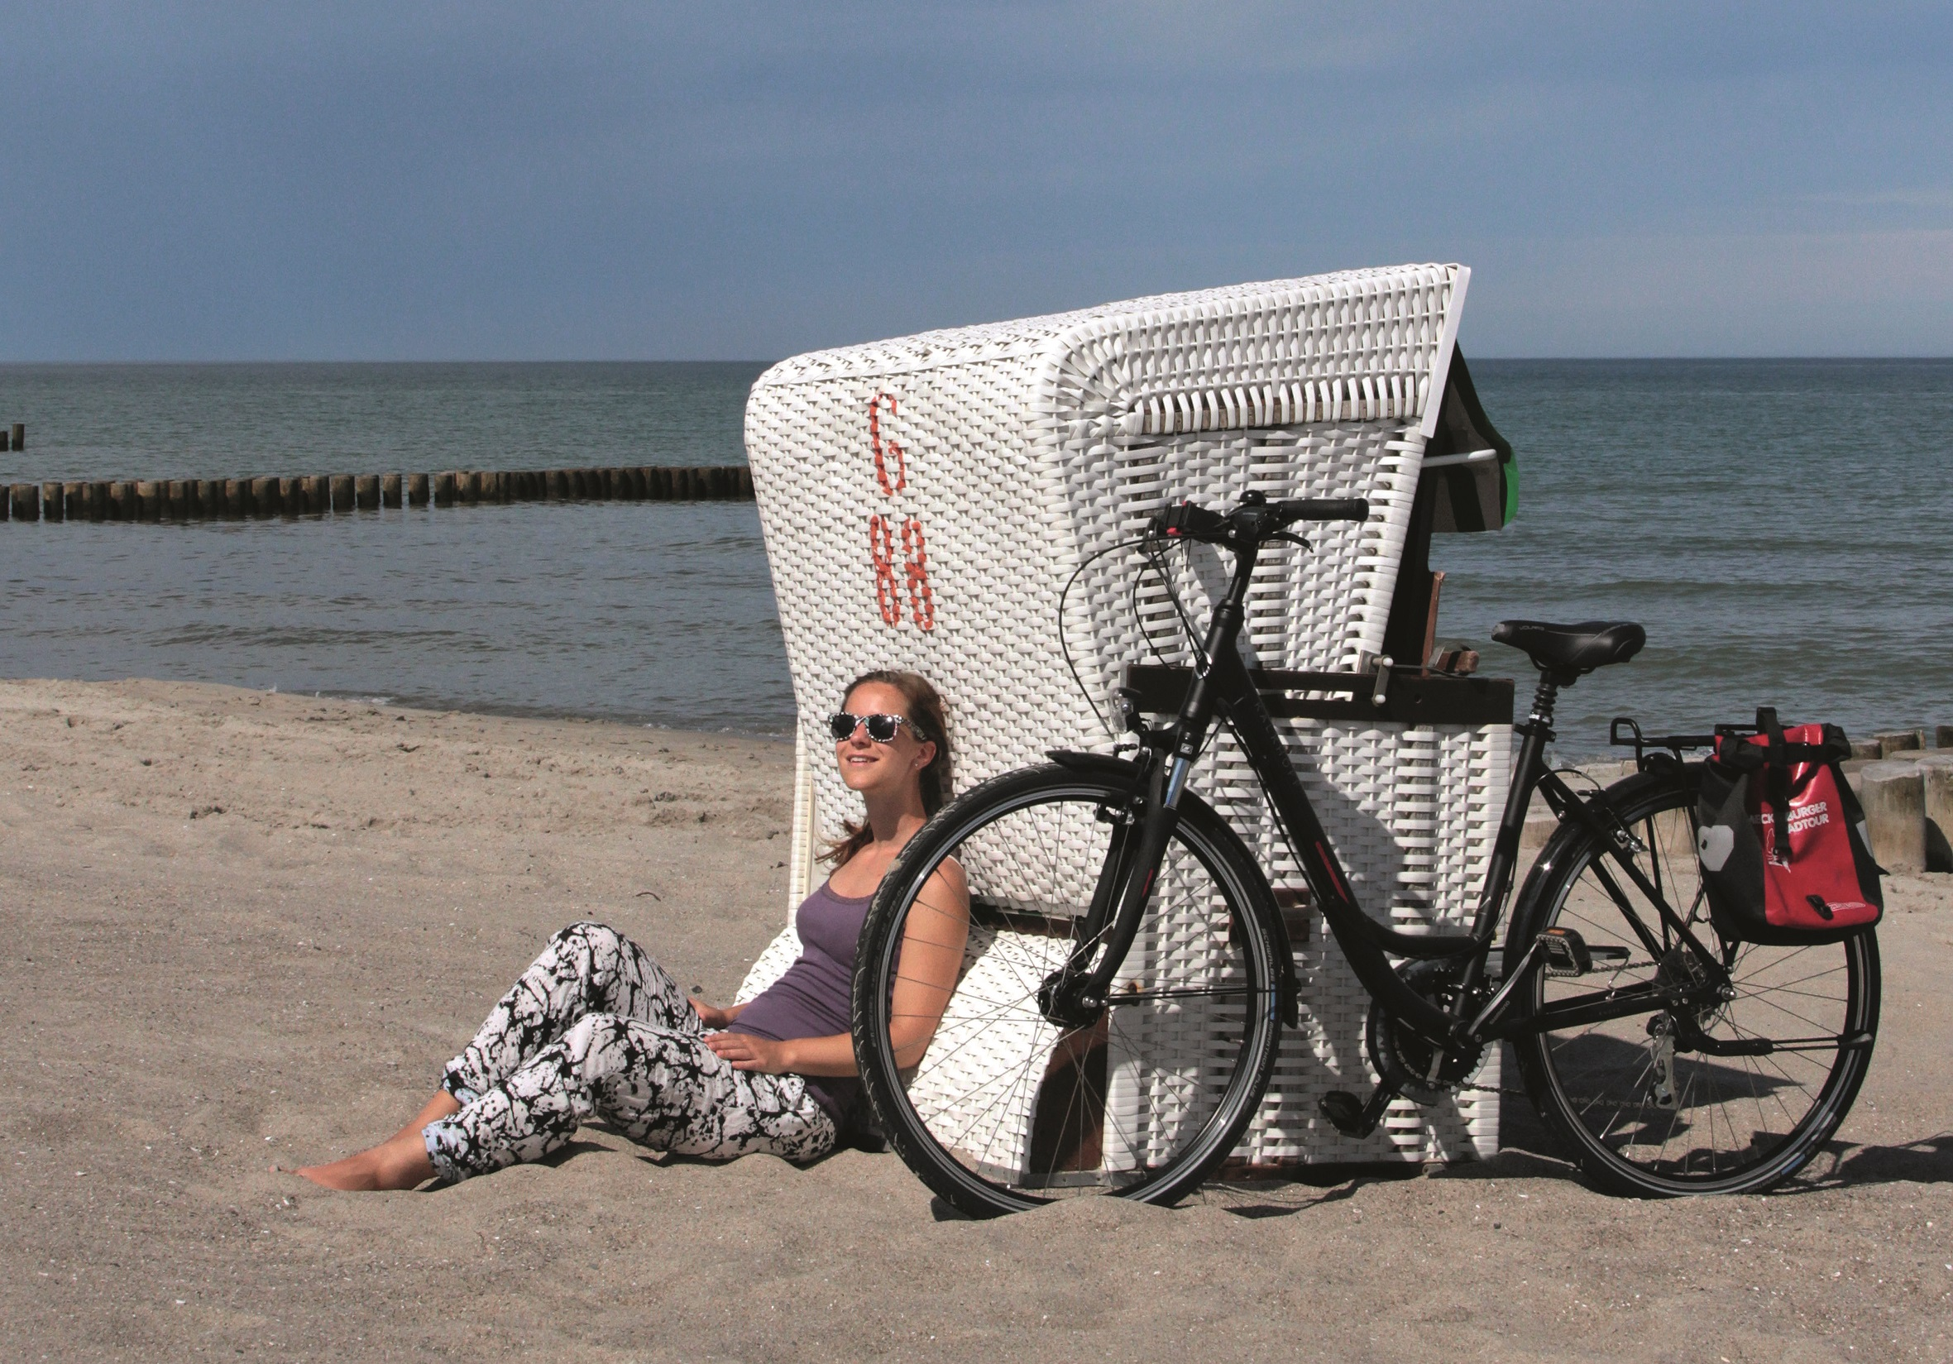
Thank you for your attention
ITB Workshop 2018

